Slide 1
Secure Cloud Network Architecture
CompTIA Security+ Exam SY0-701
Lesson 6

Slide 2
Cloud Infrastructure
Lesson 6
Topic 6A

Slide 3
Cloud Deployment Models
Public (or multi-tenant)
Private
  Hosted Private
Community
Hybrid Cloud
Notes:
Hybrid deployment models are by far the most common type.

Slide 4
Cloud Deployment Models
Security Considerations
Single-tenant architecture
Multi-tenant architecture
Hybrid architecture
Serverless architecture

Slide 5
Cloud Service Models
Models
  Software as a Service
  Platform as a Service
  Infrastructure as a Service
Third-Party Vendors

Slide 6
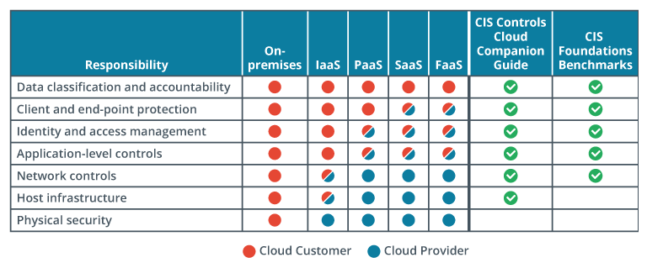
Responsibility Matrix
Describes the balance of responsibility between a customer and a cloud service provider
Responsibility model
Notes:
Identifying the boundary between customer and cloud provider responsibilities, in terms of security, is imperative for reducing the risk of introducing vulnerabilities into your environment.

Slide 7
Responsibility Matrix
Cloud Service Provider
  Physical security of the infrastructure
  Securing computer, storage, and network equipment
  Securing foundational elements of networking, such as DDoS protection
  Cloud storage backup and recovery
  Security of cloud infrastructure resource isolation among tenants
  Tenant resource identity and access control
  Security, monitoring, and incident response for the infrastructure
  Securing and managing the datacenters located in multiple geographic regions

Slide 8
Responsibility Matrix
Cloud Service Customer
  User identity management
  Configuring the geographic location for storing data and running services
  User and service access controls to cloud resources
  Data and application security configuration
  Protection of operating systems, when deployed
  Use and configuration of encryption, especially the protection of keys

Slide 9
Centralized and Decentralized Computing
Centralized computing architecture
  All data processing and storage is performed in a single location
  All users and devices rely on the central server/authority
Decentralized computing architecture
  Data processing and storage distributed across multiple locations or devices
  Increasingly important design trend impacting modern infrastructures
Notes:
Decentralization is a trend gaining greater momentum in recent years. A decentralized model reduces the risks associated with centralizing all control and authority to a single entity. Common examples include TOR and blockchains.

Slide 10
Centralized and Decentralized Computing
Decentralized computing examples
  Blockchain
  Peer-to-peer (P2P)
  Content Delivery Networks (CDNs)
  Internet of Things (IoT)
  Distributed databases
  TOR (The Onion Router)

Slide 11
Resilient Architecture Concepts
Replication
High Availability Across Zones
  Local replication
  Regional replication
  Geo-redundant storage (GRS)
Notes:
Resiliency describes the ability to maintain operations in the presence of adversity, which is a practiacal approach to cybersecurity.

Slide 12
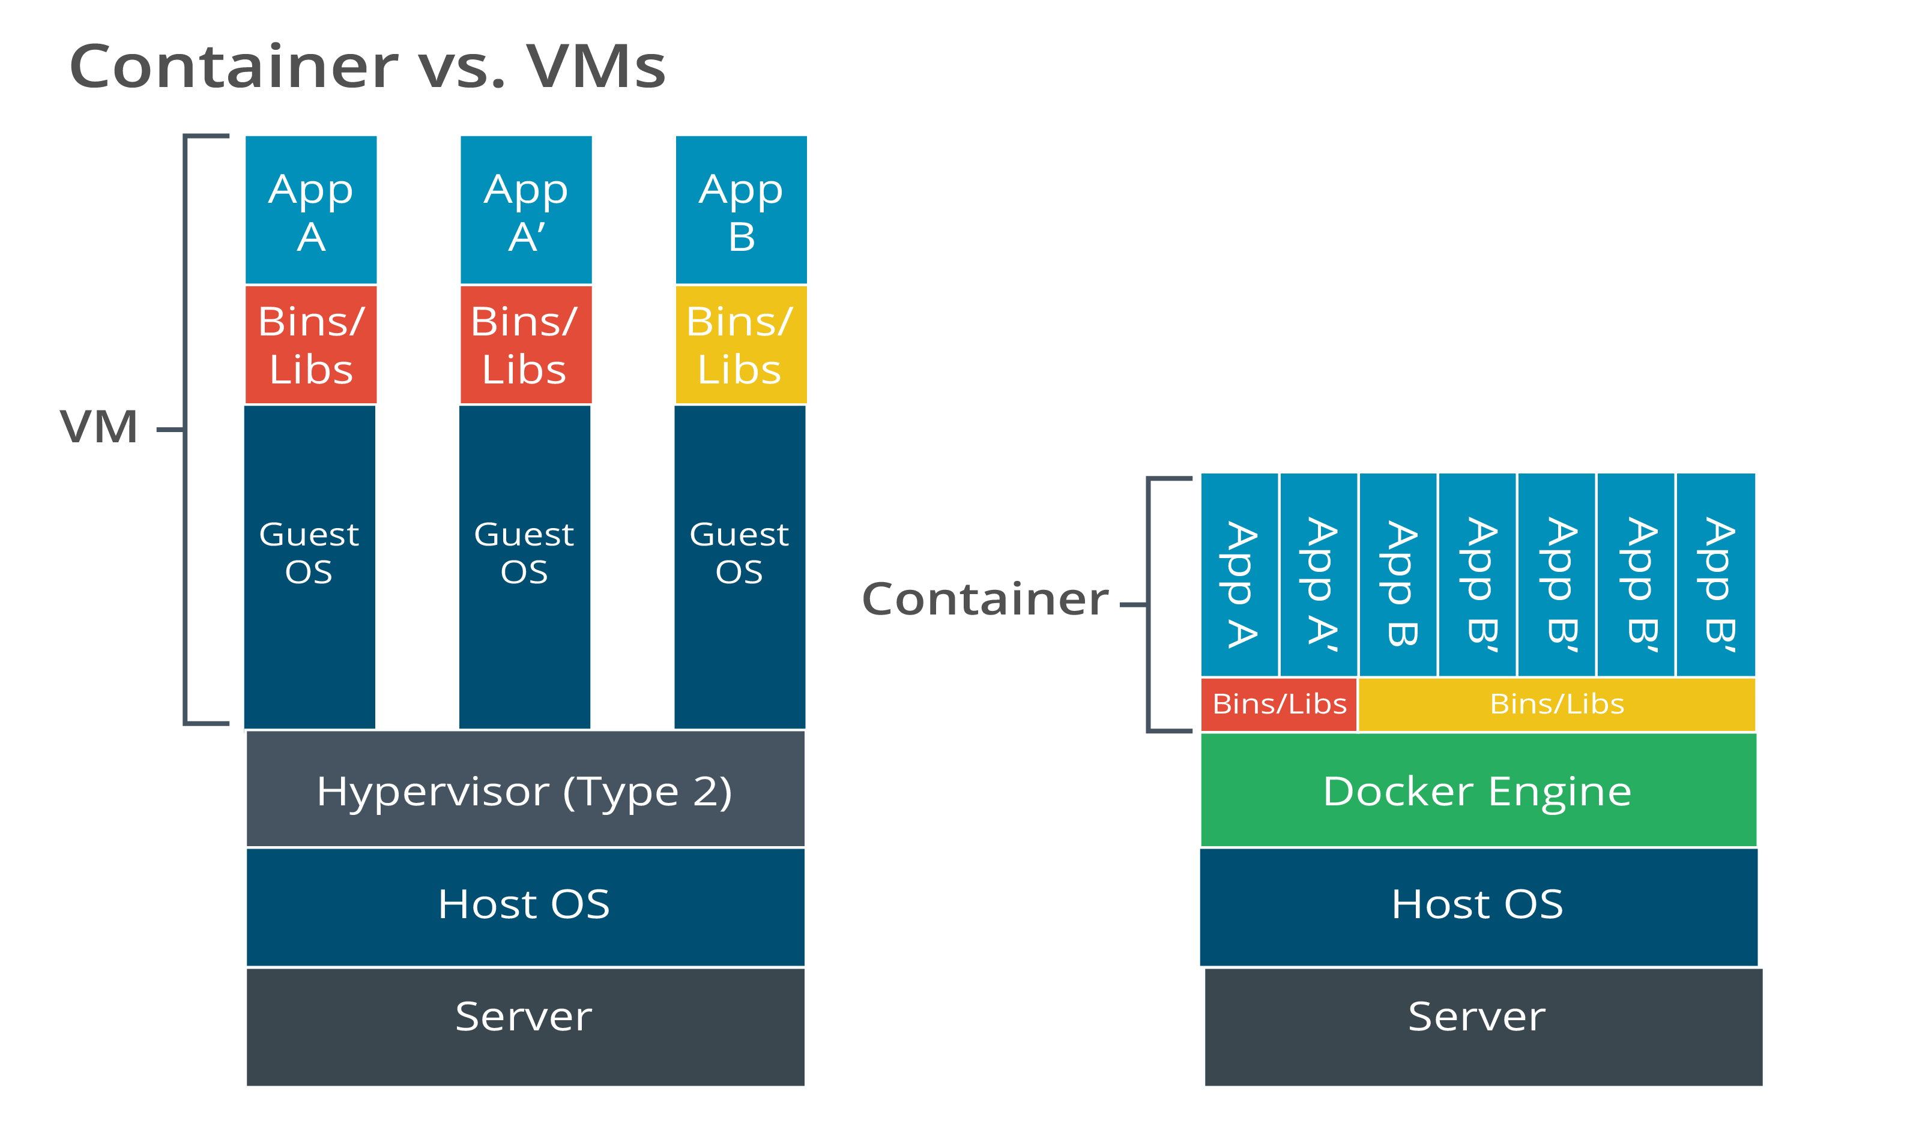
Application Virtualization and Container Virtualization
Application virtualization
Containerization
Container versus virtual machine
Comparison of VMs versus containers.

Slide 13
Cloud Architecture
Virtual Private Cloud (VPC)
  A cloud computing model in which the cloud provider manages the infrastructure and automatically allocates resources as needed, charging only for the actual usage of the application
Serverless Computing
  A private network segment made available to a single cloud consumer on a public cloud
Microservices
  An architectural approach to building software applications as a collection of small and independent services focusing on a specific business capability
Notes:
Public cloud platforms provide unique capabilities and serverless and microservices are two examples. They remove the complexities of setting up and managing underlying infrastructure.

Slide 14
Cloud Automation Technologies
Infrastructure as Code (IaC)
Responsiveness
  Load Balancing
  Edge Computing
  Auto-Scaling
Notes:
Infrastructure as Code is closely associated with DevOps & CI/CD. Infrastructure and services can be deployed through software-driven mechanisms using tools like HashiCoprp's Terraform.

Slide 15
Software Defined Networking
Network functions are divided into three “planes”
Control plane
  Decisions about how traffic should be prioritized, secured, and where it should be switched
Data plane
  Handles the switching and routing of traffic and imposition of security access controls
Management plane
  Monitors traffic conditions and network status
Notes:
You can refer students to Cisco's website for more information about SDN (cisco.com/c/en/us/solutions/software-defined-networking/overview.html).

Slide 16
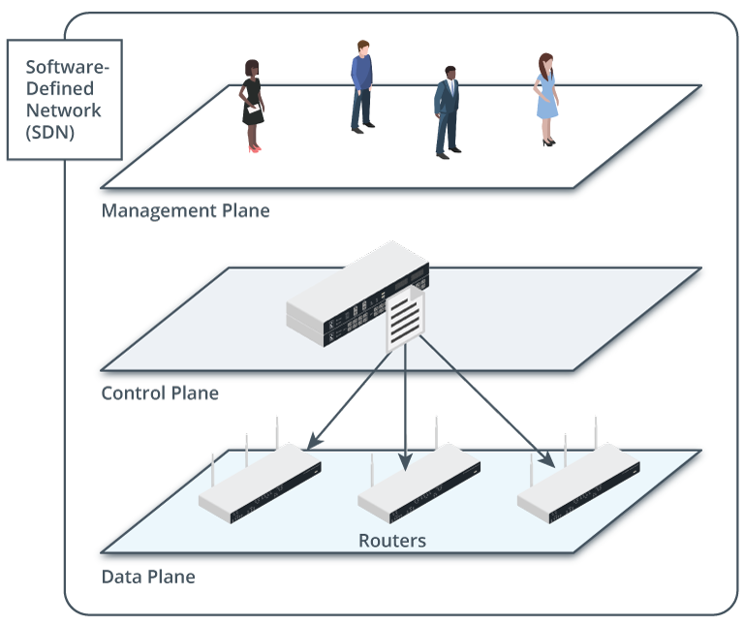
Software Defined Networking
SDN is an important part of the latest automation and orchestration technologies
SDN architecture reduces complexity of enforcing security policy
Enables fully automated deployment (or provisioning) of network links, appliances, and servers
Data plane devices managed by a control plane device and monitored by a management plane. (Images © 123RF.com.)
Notes:
You can refer students to Cisco's website for more information about SDN (cisco.com/c/en/us/solutions/software-defined-networking/overview.html).

Slide 17
Cloud Architecture Features
Considerations for Cloud Infrastructure
Cost
Scalability
Resilience
Ease of deployment
Ease of recovery
SLA and ISA
Power
Compute
Notes:
Disaster recovery planning is still essential and should include procedures for restoring critical systems, data, and applications and communicating with customers and other stakeholders. Additionally, testing and validation, service-level agreements, and incident response procedures must all be carefully considered when evaluating the ease of recovery of cloud infrastructure.

Slide 18
Cloud Security Considerations
Considerations for Cloud Infrastructure Security
Data protection
Patching
Secure Communication
  Software-Defined Wide Area Network (SD-WAN)
Secure Access
  Secure Access Service Edge (SASE)

Slide 19
Cloud Infrastructure
Cloud Deployment Models
Cloud Services Models
Responsibility Matrix
Centralized and Decentralized Computing
Resilient Architecture Concepts
Application Virtualization and Container Virtualization
Cloud Architecture
Cloud Automation Technologies
Software Defined Networking
Cloud Architecture Features
Cloud Security Considerations
Notes:
You can either complete the review questions in class with the students or simply make them aware of them as resources to use as they review the course material before the exam. Students can also review additional practice questions from the Practice tab for the course on the CompTIA Learning Center (https://learn.comptia.org/login). Note that the exam itself features multiple-choice questions. A multiple-choice practice test featuring questions and domain weightings similar to the actual exam is also available on the CompTIA Learning Center.

Slide 20
Assisted Lab: Using Containers
Assisted Lab: Using Virtualization

Slide 21
Embedded Systems and Zero Trust Architecture
Lesson 6
Topic 6B

Slide 22
Embedded Systems
Specialized computers
Many consumer and commercial use cases.
Some examples:
  Home appliances
  Smartphones and tablets
  Automotive systems
  Industrial automation
  Medical devices
  Aerospace and defense
Real-Time Operating Systems
Notes:
Explain the way that embedded systems are "same, but different" compared to PCs. The functions for CPU, memory, storage, and networking are still there, but the requirements are different (availability, predictability, and cost are prioritized over flexibility).

Slide 23
Industrial Control Systems
Industrial control systems (ICSs)
  Human-machine interfaces (HMIs)
  Data historian
  Programmable Logic Controller (PLC)
  Supervisory Control and Data Acquisition (SCADA)
ICS/SCADA Applications
  Energy
  Industrial
  Fabrication and manufacturing
  Logistics
  Facilities
Notes:
Industrial controls different from typical computing systems in that they interact with, the physical world. Problems with industrial controls can result in natural disasters and loss of life.

Slide 24
Internet of Things
Network of physical devices, vehicles, appliances, and other objects embedded with sensors, software, and connectivity, enabling them to collect and exchange data
The significantly decreased cost of IoT sensors and devices over the past few years has made them more affordable and accessible to businesses and consumers
Advances in connectivity technology, such as 5G and low-power wireless networks, have made connecting and managing large numbers of IoT devices easier and more efficient

Slide 25
Internet of Things
Security Risks Associated with IoT
Many IoT devices have limited processing power and memory
  Difficult to implement stringent security controls
Rushed to market
  Lacking or misrepresented security capability
  “Un-patchable”
Lack of standards in design of IoT devices
Collect and transmit sensitive information
Notes:
With Internet of Things and wearable technology, evaluation of the supply chain is critical. Vendors and OEMs must be assessed for their security awareness.

Slide 26
Internet of Things
Best Practice Guidance for IoT
The Internet of Things Security Foundation (IoTSF)
  https://iotsecurityfoundation.org
Industrial Internet Consortium (IIC) Security Framework
  https://www.iiconsortium.org/iisf/
Cloud Security Alliance (CSA) IoT Security Controls Framework
  https://cloudsecurityalliance.org/artifacts/iot-security-controls-framework
European Telecommunications Standards Institute (ETSI) IoT Security Standards
  https://www.etsi.org/technologies/consumer-iot-security

Slide 27
Deperimeterization and Zero Trust
Deperimeterization
  Shifts focus from defending the network boundaries to protecting individual resources
Zero Trust
  “Never trust, always verify”
Notes:
Discuss the concept of deperimeterization and ask if attendees see this in their own organizations.

Slide 28
Deperimeterization and Zero Trust
Trends Driving Deperimeterization
Cloud
Remote Work
Mobile
Outsourcing & Contracting
Wireless Networks

Slide 29
Deperimeterization and Zero Trust
The Key Benefits of a Zero Trust Architecture
Greater security
Better access controls
Improved governance and compliance
Increased granularity

Slide 30
Deperimeterization and Zero Trust
Essential Components of a Zero Trust Architecture
Network and endpoint security
Identity and access management (IAM
Policy-based enforcement
Cloud security
Network visibility
Network segmentation
Data protection
Threat detection and prevention

Slide 31
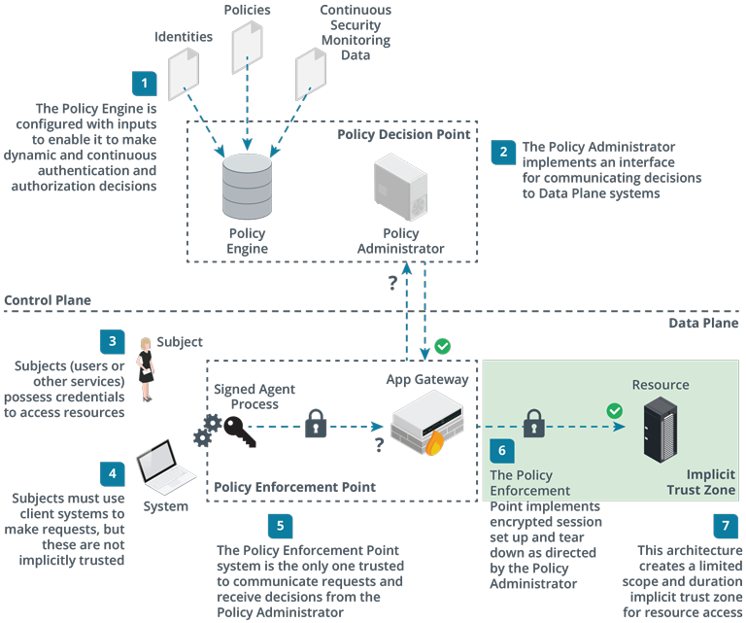
Zero Trust Security Concepts
Assumes that all devices, users, and services are not inherently trusted, regardless of whether inside or outside a network's perimeter
Components in NIST's zero trust architecture framework.
Notes:
The processes implementing the policy enforcement point are the only ones permitted to interface with the policy administrator. It is critical to establish a root of trust for these processes so that policy decisions cannot be tampered with.

Slide 32
Embedded Systems and Zero Trust Architecture
Embedded Systems
Industrial Control Systems
Internet of Things
Deperimeterization and Zero Trust
Notes:
You can either complete the review questions in class with the students or simply make them aware of them as resources to use as they review the course material before the exam. Students can also review additional practice questions from the Practice tab for the course on the CompTIA Learning Center (https://learn.comptia.org/login). Note that the exam itself features multiple-choice questions. A multiple-choice practice test featuring questions and domain weightings similar to the actual exam is also available on the CompTIA Learning Center.

Slide 33
Summary
CompTIA Security+ Exam SY0-701
Lesson 6

